Slide 1
Section R.7
Rational Expressions
Copyright © 2012 Pearson Education, Inc. Publishing as Prentice Hall.

Slide 2
Copyright © 2012 Pearson Education, Inc. Publishing as Prentice Hall.

Slide 3


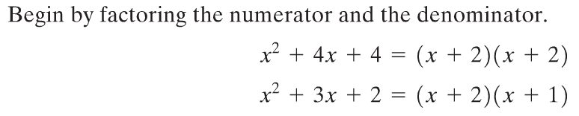
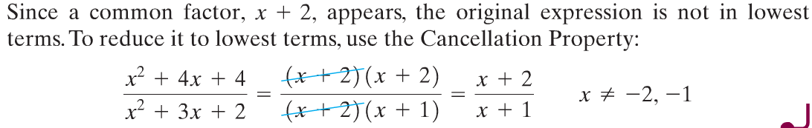
Copyright © 2012 Pearson Education, Inc. Publishing as Prentice Hall.

Slide 4
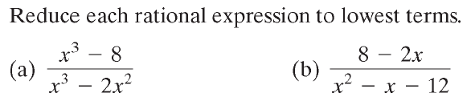
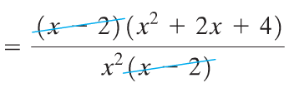




Copyright © 2012 Pearson Education, Inc. Publishing as Prentice Hall.

Slide 5
Copyright © 2012 Pearson Education, Inc. Publishing as Prentice Hall.

Slide 6

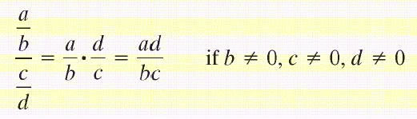
Copyright © 2012 Pearson Education, Inc. Publishing as Prentice Hall.

Slide 7
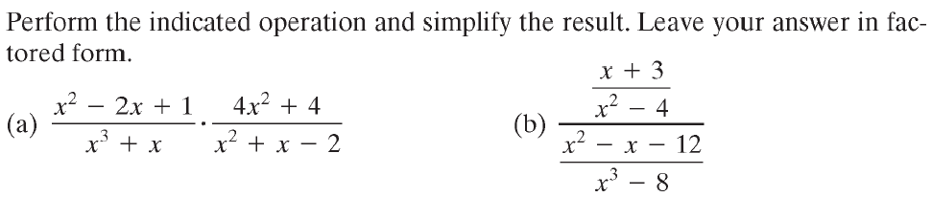







Copyright © 2012 Pearson Education, Inc. Publishing as Prentice Hall.

Slide 8
Copyright © 2012 Pearson Education, Inc. Publishing as Prentice Hall.

Slide 9
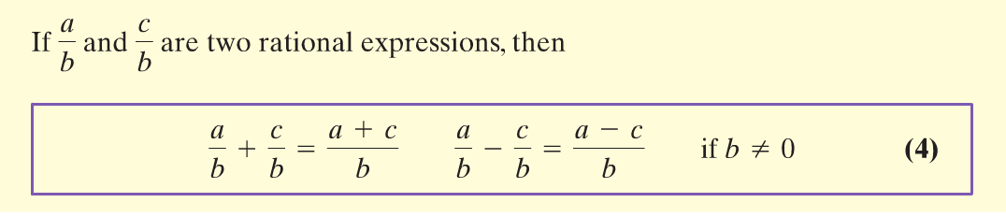
Copyright © 2012 Pearson Education, Inc. Publishing as Prentice Hall.

Slide 10

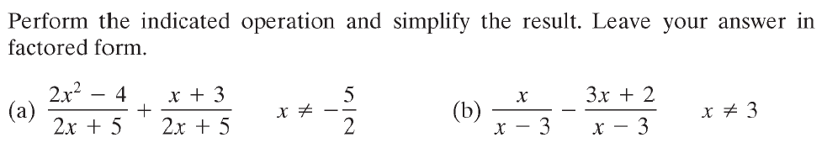








Copyright © 2012 Pearson Education, Inc. Publishing as Prentice Hall.

Slide 11
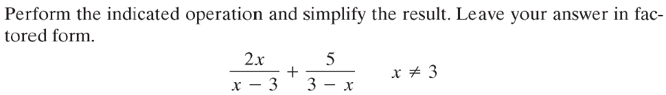
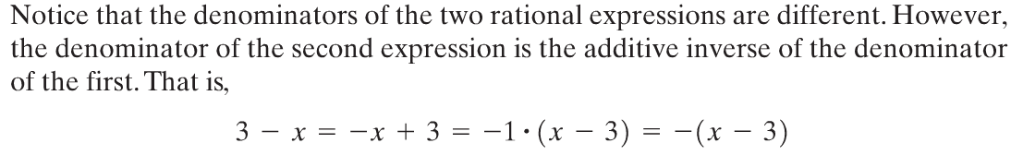
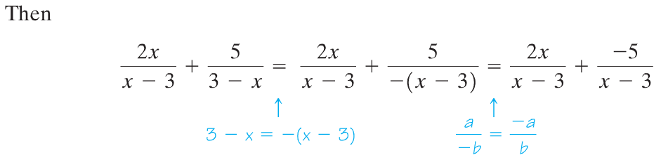

Copyright © 2012 Pearson Education, Inc. Publishing as Prentice Hall.

Slide 12
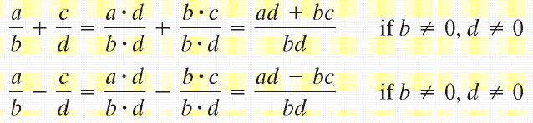
Copyright © 2012 Pearson Education, Inc. Publishing as Prentice Hall.

Slide 13

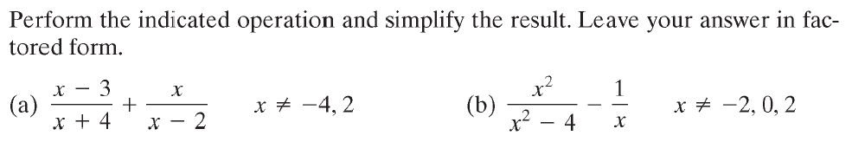
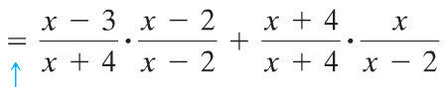



Copyright © 2012 Pearson Education, Inc. Publishing as Prentice Hall.

Slide 14
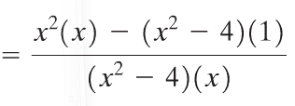
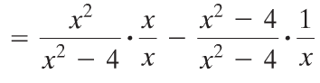
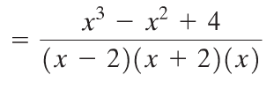
Copyright © 2012 Pearson Education, Inc. Publishing as Prentice Hall.

Slide 15
Copyright © 2012 Pearson Education, Inc. Publishing as Prentice Hall.

Slide 16
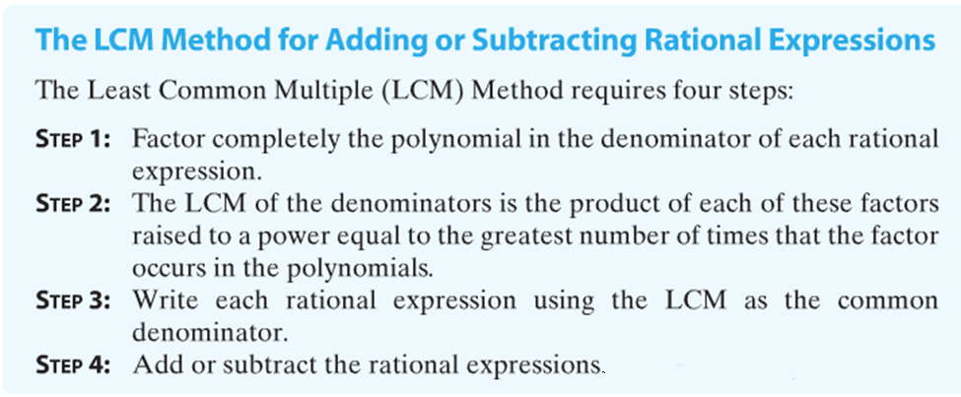
Copyright © 2012 Pearson Education, Inc. Publishing as Prentice Hall.

Slide 17

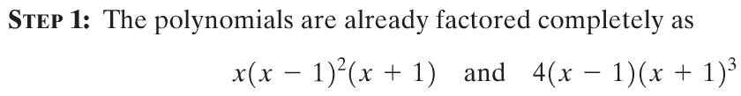
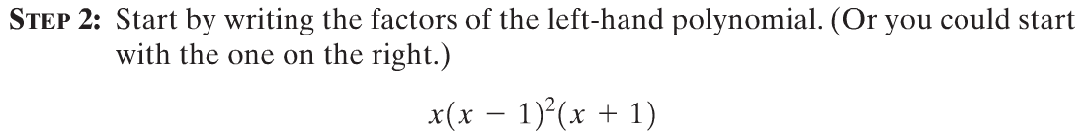
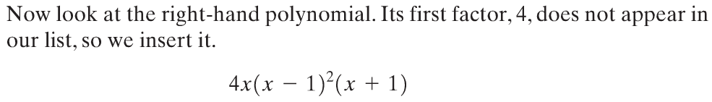
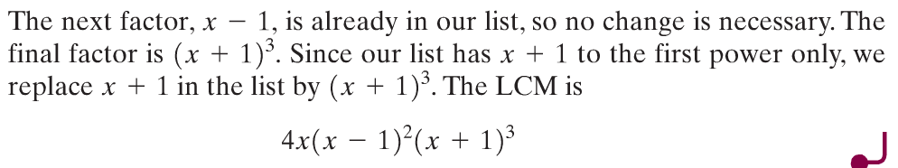
Copyright © 2012 Pearson Education, Inc. Publishing as Prentice Hall.

Slide 18
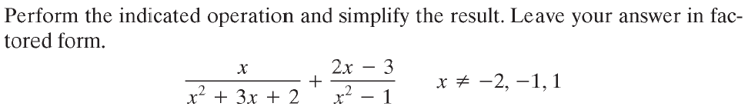
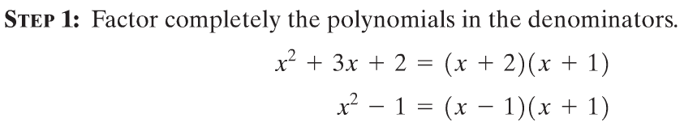
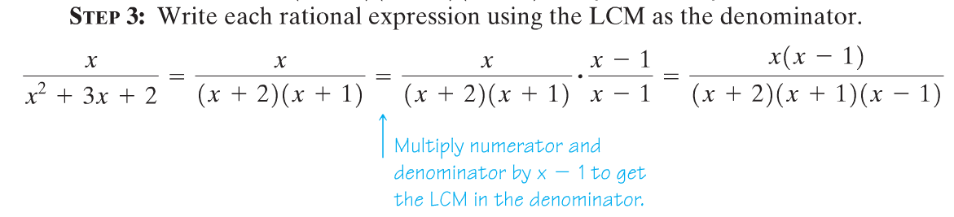
Copyright © 2012 Pearson Education, Inc. Publishing as Prentice Hall.

Slide 19
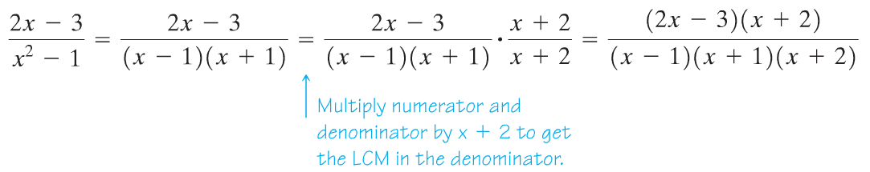
Copyright © 2012 Pearson Education, Inc. Publishing as Prentice Hall.

Slide 20
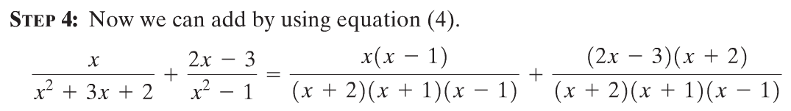



Copyright © 2012 Pearson Education, Inc. Publishing as Prentice Hall.

Slide 21

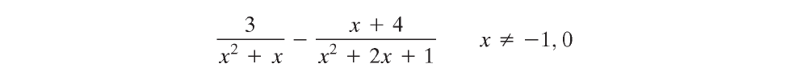
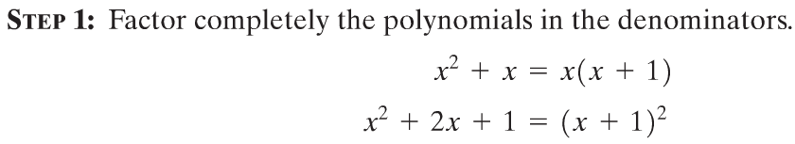

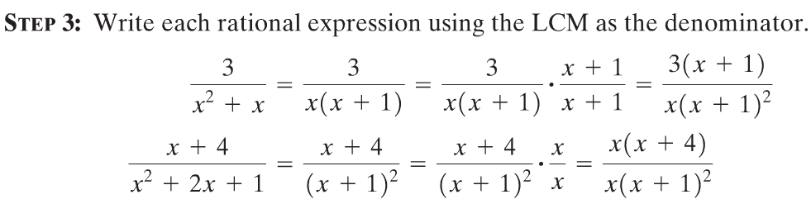
Copyright © 2012 Pearson Education, Inc. Publishing as Prentice Hall.

Slide 22
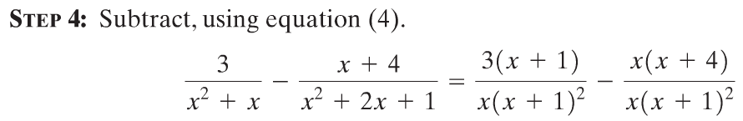



Copyright © 2012 Pearson Education, Inc. Publishing as Prentice Hall.

Slide 23
Copyright © 2012 Pearson Education, Inc. Publishing as Prentice Hall.

Slide 24
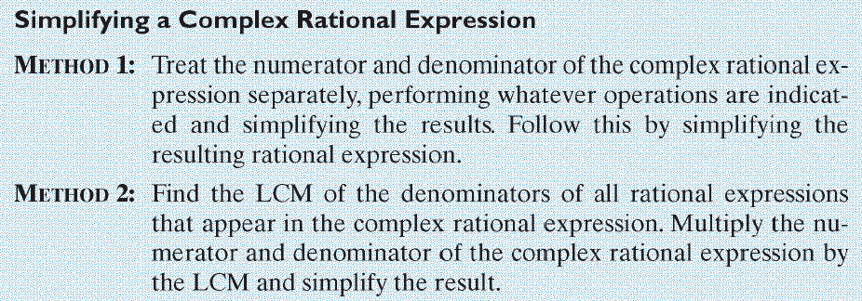
Copyright © 2012 Pearson Education, Inc. Publishing as Prentice Hall.

Slide 25
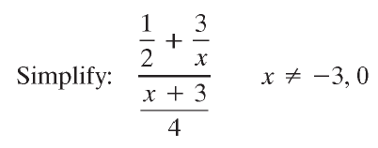
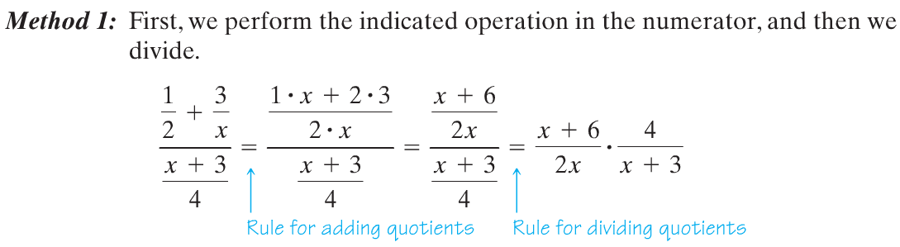
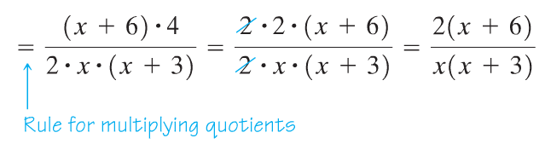
Copyright © 2012 Pearson Education, Inc. Publishing as Prentice Hall.

Slide 26
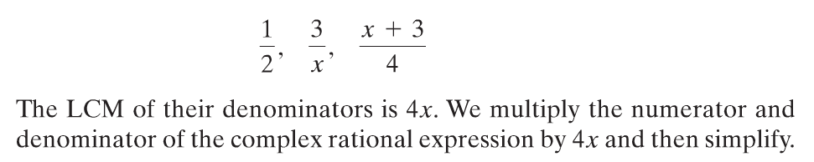
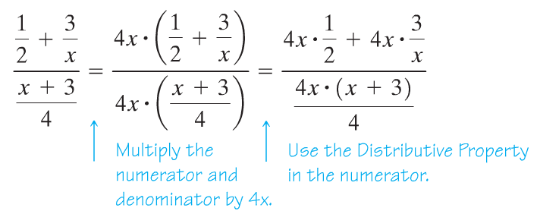
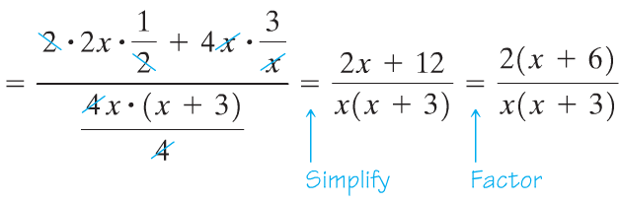
Method 2: The rational expressions that appear in the complex rational expression are
Copyright © 2012 Pearson Education, Inc. Publishing as Prentice Hall.

Slide 27
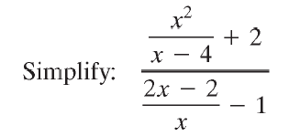
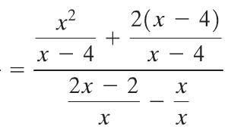
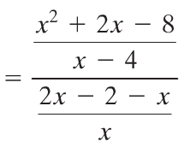
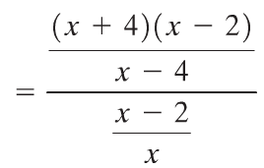
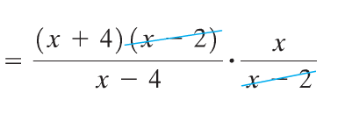

Copyright © 2012 Pearson Education, Inc. Publishing as Prentice Hall.

Slide 28
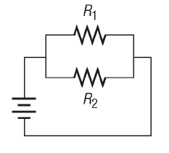
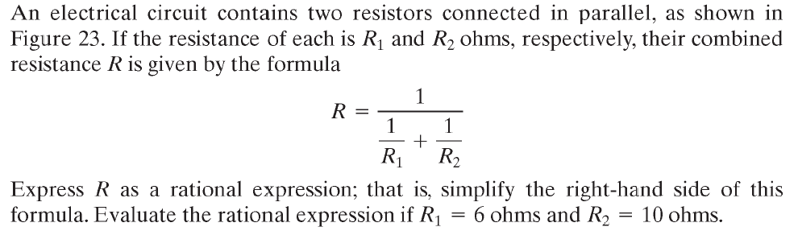
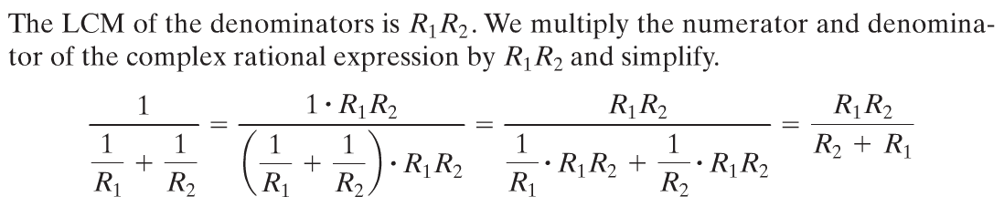

An electrical circuit contains two resistors connected in parallel, as shown in the figure below. If the resistance of each is R₁ and R₂ ohms, respectively, their combined resistance R is given by the formula
Copyright © 2012 Pearson Education, Inc. Publishing as Prentice Hall.

